Slide 1
Undirected Single-Source Shortest Paths with Positive Integer Weights in Linear Time
MIKKEL THORUP
1999 Journal of the ACM

Slide 2
Presenters
資訊四 巨彥霖
資訊四 羅婉嫣
資訊四 許恒瑞

Slide 3
Outline
Introduction
Preliminary
Avoiding the Sorting Bottleneck
The Component Hierarchy
Visiting Minimal Vertices
Towards Linear Time
The Component Tree

Slide 4

Introduction(1)
Mikkel Thorup
  http://www.diku.dk/~mthorup/

Slide 5
Introduction(2)
S
S
S
P
ingle
ource
hortest
ath
Shortest path
problem
S
Shortest path
Shortest path
Given a positively weighted graph G with a source vertex s,
find the shortest path from s to all other vertices in the graph

Slide 6
Introduction(3)
History
Since 1959, all developments in SSSP have been based on Dijkstra’s algorithm (1959)

Slide 7





Dijkstra’s algorithm(1)
D(v)
∞
Notation:
  G = (V, E)
    | v | = n , | E | = m
  weighted function l : edge → positive integer
    If (v, w) E , define l(v, w) = ∞
  d(v) : distance from s to v
  D(v) : super distance
    D(v) ≧ d(v)
a set S V
v S : D(v) = d(v)
v S : D(v) = min { d(u) + l(u, v) }
80
u S
v can go to S
53
D(v) : super distance
v can go to S
20
d(v)
10
13

Slide 8
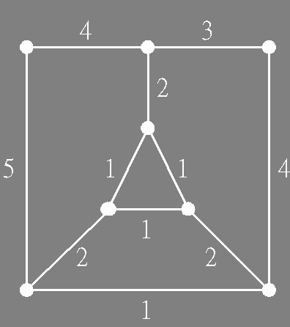
Dijkstra’s algorithm(2)
V = {
}
v6
v8
v1
v4
v7
v8
v1
v3
v4
v7
v3
v5
v2
v5
v6
v2
v1
min
v3
v2
0
7
0
∞
4
7
4
}
S = {
6
v5
6
∞
v4
visit
v6
Initially
v3
7
v8
7
∞
∞
7
v6
v5
v4
min
v2
v7
v1
5
5
∞
6
6
v7
v8
Increasing order

Slide 9
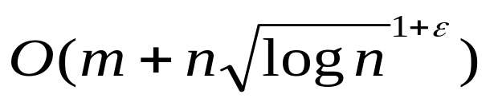
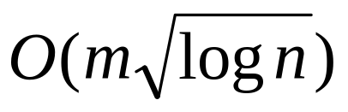
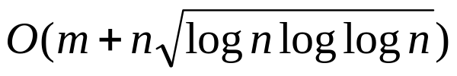
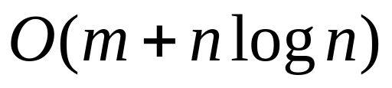
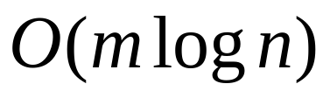
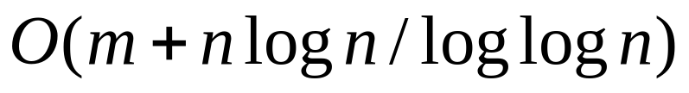

Introduction(3)
History
Thorup’s priority queue :
(1996)
Raman :
(1996)
Fredman & Willard’s fusion trees :
(1993)
Fredman & Tarjan Fibonacci heaps :
(1987)
Fredman & Willard’s atmoic heaps :
(1994)
Applying William’s heap :
(1964)
Simple :
O(m)
our target !!
Dijkstra’s algorithm
(1959)

Slide 10

Introduction(4)
In fact, Dijkstra’s algorithm can be implemented in linear time ⬄
( [Fredman & Tarjan 1987] , [Thorup 1996] )
linear time sorting
Since we do not know how to sort in linear time, this implies that we are deviating from Dijkstra’s algorithm in that we do not visit the vertices in order of increasing distance from s.
Our algorithm is based on a hierarchical bucketing structure.
  ➔ may visit the vertices in any order

Slide 11
Outline
Introduction
Preliminary
Avoiding the Sorting Bottleneck
The Component Hierarchy
Visiting Minimal Vertices
Towards Linear Time
The Component Tree

Slide 12
Preliminary(1)
Lemma 1
  If v S\V minimize D(v) , D(v) = d(v)
Lemma 2
  minD(V\S) = mind(V\s) is non-decreasing

Slide 13

Preliminary(2)
Notation:
  x >> i
    is [ x / 2 ]
    If x ≦ y => x >> i ≦ y >> i
  If W V , minD(W) >> i
    is (min{ D(w) | w W }) >> i
i

Slide 14
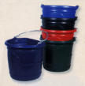
Preliminary(3)
Bucket
  which elements can be inserted and deleted,and from which we can pick out an unspecified element.
  each operation should be supported in constant time.

Slide 15
Outline
Introduction
Preliminary
Avoiding the Sorting Bottleneck
The Component Hierarchy
Visiting Minimal Vertices
Towards Linear Time
The Component Tree

Slide 16
Avoiding the Sorting Bottleneck(1)
Dijkstra’s algorithm
  visit the vertices in order of increasing D(v)
New approach
  visit the vertices where D(v) = d(v)
  D(v) ≧ min D(V\S)

Slide 17
Avoiding the Sorting Bottleneck(2)
For some i, v V_{i}\S,
D(v) = min D(V_{i}\S)
≦ min D(V\S) + δ
d(v) = D(v)
0
4
∞
∞
∞
∞
5
∞
δ
V₁
V₂
V₃

Slide 18
Avoiding the Sorting Bottleneck(3)
Criteria on D(v) = d(v)
  D(v) = min D(V_{i}\S) ≦ min D(V\S) + δ
  <= min D(V_{i}\S) ≦ min D(V\S) + 2^{α}
  <= min D(V_{i}\S) >> α ≦ min D(V\S) >> α
Bucketing structure
j
i
…
content
0
1
2
3
4
…
∞
index
D(v) ≦ Σ_{e} l(e)
Δ = Σ_{e} l(e) >> α
ix
min D(V_{i}\S) >> α
Δ+ 2

Slide 19
Avoiding the Sorting Bottleneck(4)
SSSP algorithm A
δ = 2⁰ , α = 0
4
min D(V\S) = min d(V\S) is nondecreasing
0
4
7
∞
∞
B(min D(Vi\S) >> α) = i
∞
6
ix
∞
∞
2
…
1
2
3
…
0
3
5
6
∞
5
1
2
4
7
∞
5
∞
δ
V₁
V₂
V₃

Slide 20
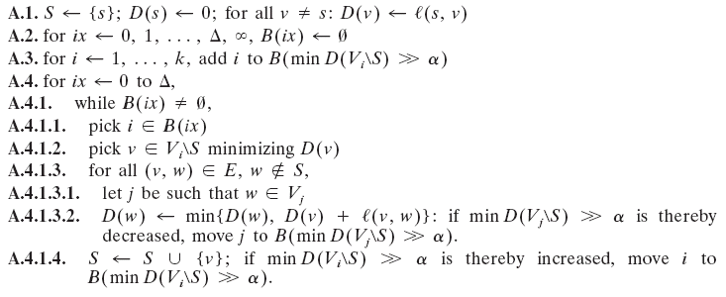
Avoiding the Sorting Bottleneck(5)
SSSP algorithm A
Δ = Σe l(e) >> α
δ = 2^{α}
O(m + Δ) + cost of maintaining min D(V_{i}\S) for each i

Slide 21
Outline
Introduction
Preliminary
Avoiding the Sorting Bottleneck
The Component Hierarchy
Visiting Minimal Vertices
Towards Linear Time
The Component Tree

Slide 22

The Component Hierarchy(1)
Definition
  G_{i}：the subgraph of G with l(e) < 2^{i}
  [v]_{i}：the connected component on level i containing v
  children of [v]_{i}：[w]_{i-1}, w [v]_{i}
v
[v]₂
[w]₁
[v]₁
v
w
G_{o}
G₁
G₂
G₃ = G

Slide 23
The Component Hierarchy(2)
Definition
  [v]_{i} is a min-child of [v]_{i+1}
  if min D([v]_{i}⁻) >> i = min D([v]_{i+1}⁻) >> i
  [v]_{i} is minimal if [v]_{j} is a min-child of [v]_{j+1} for j = i, …, b-1
[v]₂
[v]₁
v

Slide 24
The Component Hierarchy(3)
Dijkstra’s algorithm
visit v, if v V\S minimizes D(v)
i, min D([v]_{i}⁻) >> i = D([v]_{i+1}⁻) >> i = D(v) >> i => [v]₀ minimal
minimal D(v) = d(v) [v]₀ minimal
D(v) = d(v) [v]₀ minimal

Slide 25

The Component Hierarchy(4)
lemma 8
If v S and [v]_{i} is minimal, min D([v]_{i}⁻) = min d([v]_{i}⁻). In particular, D(v) = d(v) if [v]₀ = {v} is minimal.

Slide 26
Outline
Introduction
Preliminary
Avoiding the Sorting Bottleneck
The Component Hierarchy
Visiting Minimal Vertices
Towards Linear Time
The Component Tree

Slide 27
Visiting Minimal Vertices(1)
Definition
  visiting a vertex requires that [v]₀ = {v} is minimal
  when v is visited, v is moved to S and relax
Lemma 10
  For all [v]_{i},
  max d([v]_{i}\[v]_{i}⁻) >> i-1 ≦ min d([v]_{i}⁻) >> i-1
Lemma 11
  min D([v]_{i}⁻) >> i = min d([v]_{i}⁻) >> i, visiting w changes min D([v]_{i}⁻) >> i, and the change in min D([v]_{i}⁻) >> i is increased by one

Slide 28
Visiting Minimal Vertices(2)
Lemma 12, 13
  If [v]_{i} has once been minimal, in all future,
  min D([v]_{i}⁻) >> i = min d([v]_{i}⁻) >> i

Slide 29
Visiting Minimal Vertices(3)
SSSP algorithm B,C
[w]_{i} minimal
Visit([s]_{i})
s
4
∞
0
4
d(w) >> i = min D([s]_{i}⁻) >> i
min D([w]_{i-1}⁻) >> i - 1
= min D([s]_{i}⁻) >> i - 1
∞
∞
∞
Visit([w]_{i-1})
[s]₀, i = 0
[s]₁, i = 1
[s]₂, i = 2
5
∞
[s]₃ = G, i = 3

Slide 30

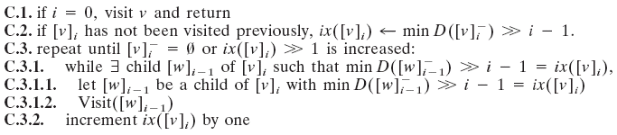
Visiting Minimal Vertices(4)
Towards Linear Time !!

Slide 31
Outline
Introduction
Preliminary
Avoiding the Sorting Bottleneck
The Component Hierarchy
Visiting Minimal Vertices
Towards Linear Time
The Component Tree

Slide 32

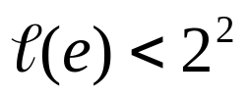
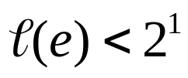
Towards Linear Time(1)
Component tree
Number of nodes
1
1
a
b
c
3
2
3
1
d
e
1
2
3
2
f
a
b
c
d
e
f

Slide 33
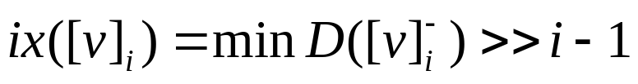
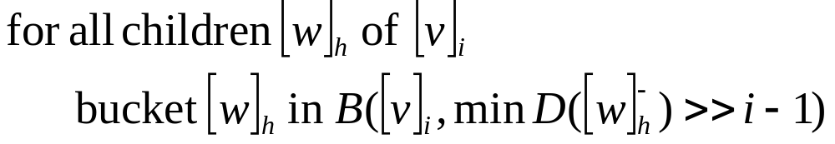
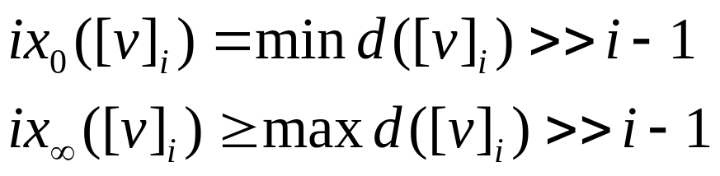
Towards Linear Time(2)
Linear size bucket structure
j
i
…
content
0
1
2
3
4
…
∞
…
index
content
ix₀
…
ix∞
index
ix
Δ = Σ_{e} l(e) >> α
Δ+ 2

Slide 34
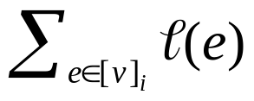
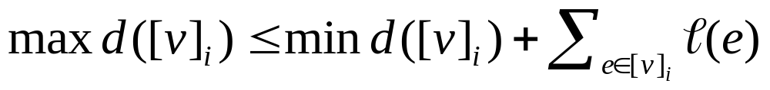
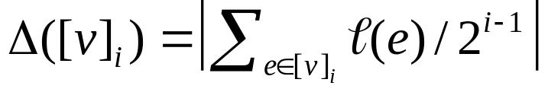

Towards Linear Time(3)
Lemma 18. The total number of relevant buckets is < 4m + 4n
  Diameter of [v]_{I} is bounded by
  =>
  Define
  =>

Slide 35
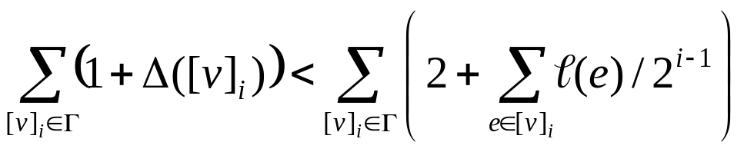

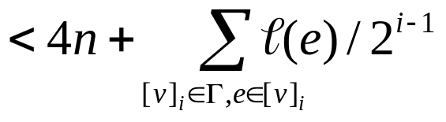
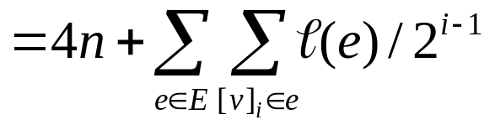

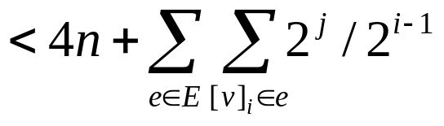
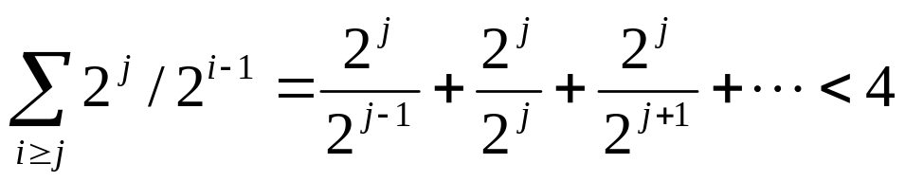
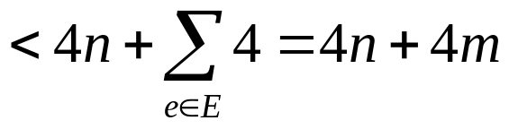
Towards Linear Time(4)
Lemma 18. The total number of relevant buckets is < 4m + 4n

Slide 36
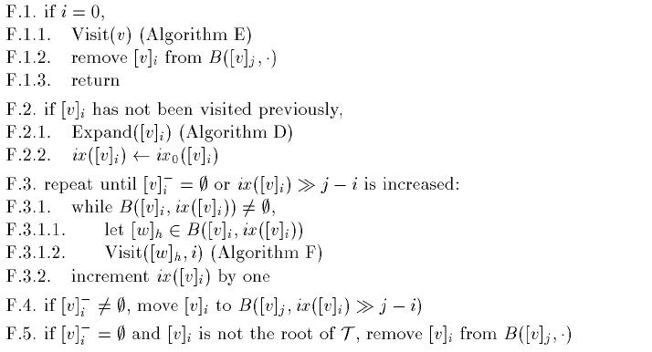
Towards Linear Time(5)

Slide 37
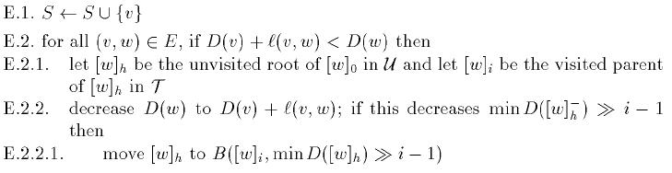
Towards Linear Time(6)
O(m)

Slide 38
Towards Linear Time(7)

Slide 39
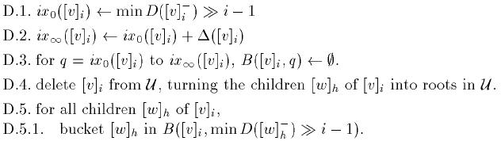


Towards Linear Time(8)
O(m)
…
content
0 0 0 0 0 0
ix₀
…
ix∞
index

Slide 40
Towards Linear Time(9)
Total: O(m)
Total: O(m)
Total: O(n)
Total: O(m)

Slide 41

Towards Linear Time(10)
Assume that the component tree has been computed in linear time. Then no more than O(m) time and space is needed to solve the SSSP problem
How to construct the component tree ?

Slide 42
Outline
Introduction
Preliminary
Avoiding the Sorting Bottleneck
The Component Hierarchy
Visiting Minimal Vertices
Towards Linear Time
The Component Tree

Slide 43
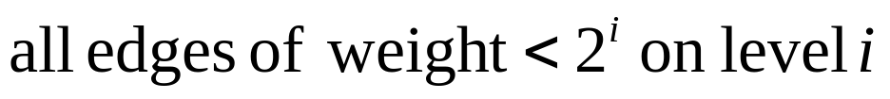
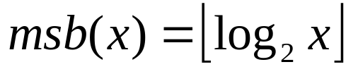
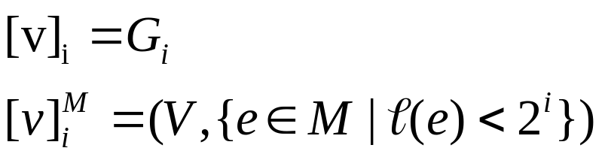
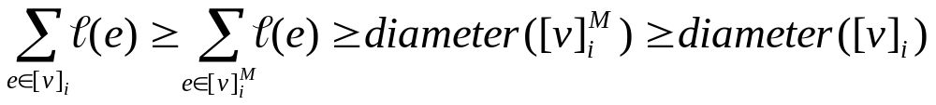
The Component Tree(1)

Slide 44
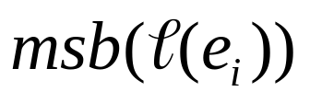
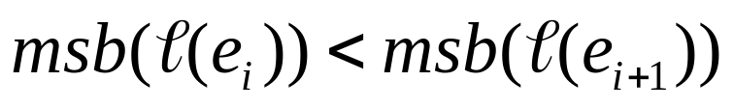
The Component Tree(2)
Use union-find operation
Let e₁, …, e_{n-1} be the edges of M sorted according to

Slide 45
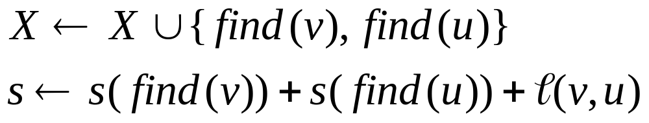
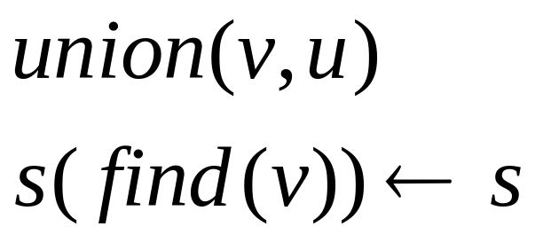
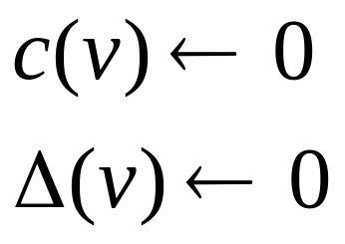
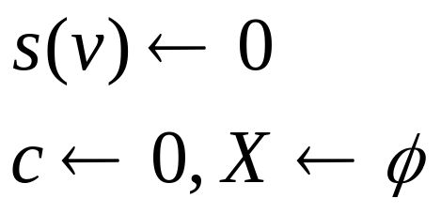
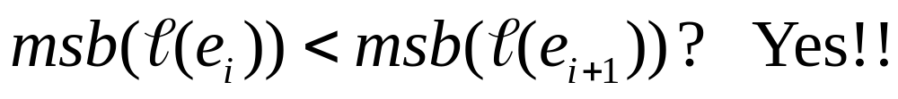
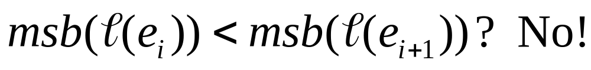
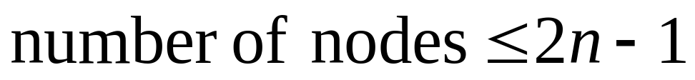
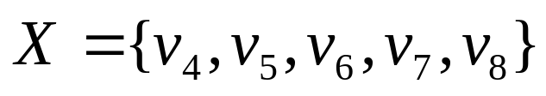
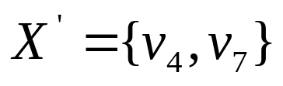
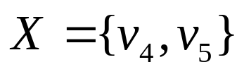

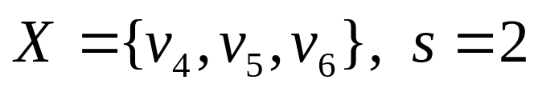
The Component Tree(3)
v₁
v₂
v₃
v1,v2,v3,v4,v5,v6,v7,v8
4
3
2
v4,v5,v6,v7,v8
v₄
v2,
v3,
5
1
1
4
v4,v5
v7,v8
v₅
,v6
v₆
1
2
2
1
v₁
v₂
v₃
v₄
v₅
v₆
v₇
v₈
v₇
v₈

